Slide 1

CSE215 Programming Language II Project:
Text Editor
This presentation will showcase the features and implementation details of a text editor built using Java Swing.

Slide 2
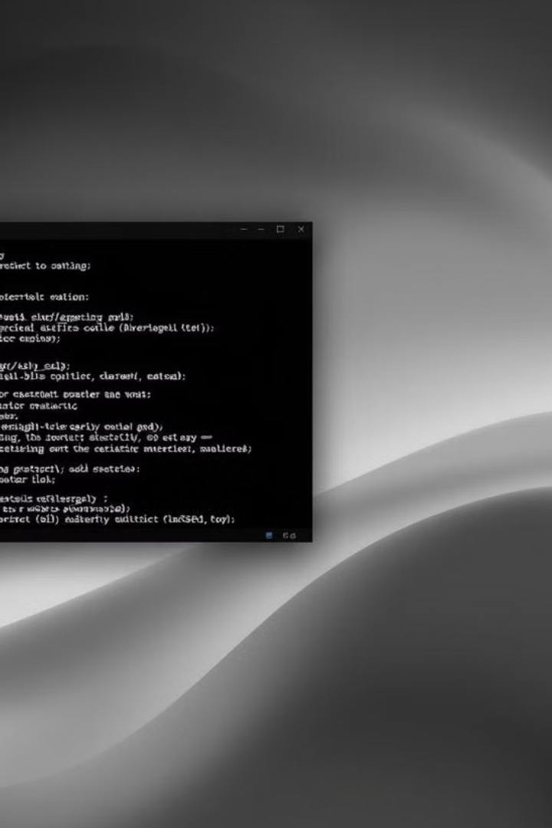
Features Overview
1
Text Editing
JTextPane provides rich text formatting capabilities.
2
Font Management
Users can customize font family, size, and color.
3
File Operations
Open, save, and handle multiple file types.
4
Syntax Highlighting
Highlights keywords, strings, and comments.

Slide 3
Implementation Details
TextEditor Class
SyntaxHighlighter Class
Constructs GUI and manages interactions.
Applies syntax highlighting using regular expressions.
Implements ActionListener for button and menu handling.
Implements DocumentListener to react to text changes.

Slide 4




Design Highlights
Event Handling
Event-driven programming for button clicks, menu selections, and document updates.
Modularization
Syntax highlighting and file operations are separated for improved maintainability.
Syntax Highlighting
Regular expressions used for pattern matching, ensuring efficiency and flexibility.

Slide 5
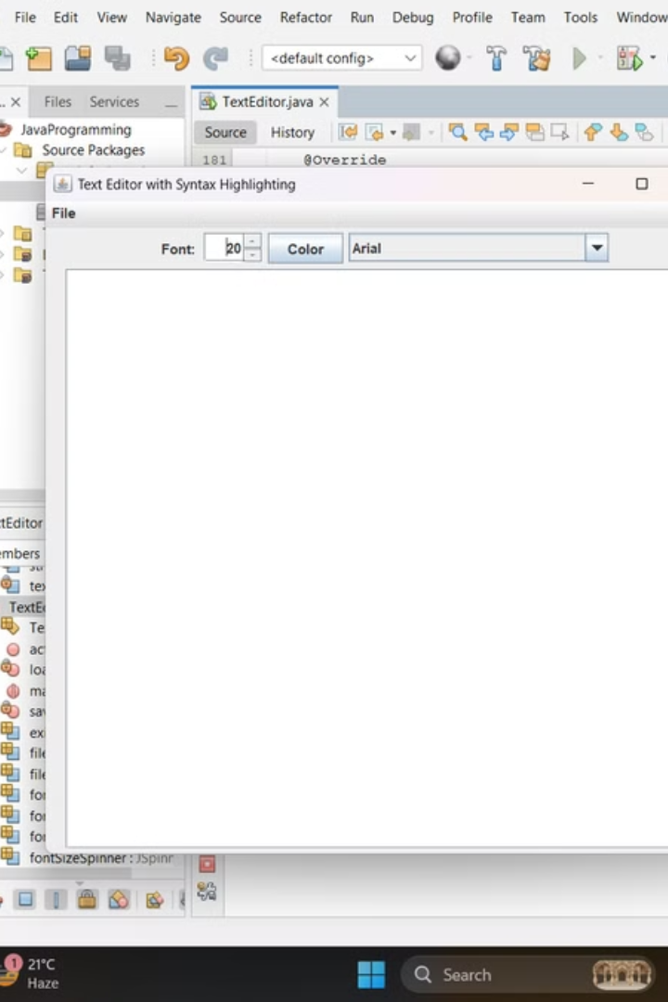
Strengths
Responsiveness
Flexibility
File operations are executed on separate threads, ensuring smooth UI performance.
Supports multiple file types and allows customization of font and color settings.
Maintainability
Separation of concerns enhances readability and future extensibility.

Slide 6

Limitations and Suggestions
1
Error Handling
Current error handling is minimal, only printed to console.
2
Syntax Highlighting Scope
Limited to predefined keywords and patterns.
3
Multithreading
File handling operations lack visual feedback during execution.
4
GUI Design
Layout can be refined for better aesthetics.

Slide 7

This text editor project demonstrates a strong foundation for building more sophisticated IDE-like tools.
…

